Slide 1
CRIME SCENE DO NOT CROSS
CRIME SCENE DO NOT
Crime Rate Across Counties in the United States
Lindsay Carr, Yawei Fei, Grant Gittins, William Jackson
CRIME SCENE DO NOT CROSS
CRIME SCENE DO NOT CROSS
CRIME S

Slide 2
INTRODUCTION
CRIME SCENE DO NOT CROSS
Violent crime has been a persistent problem that has continued to plague the United States. In recent years, violent crime has increased, relative to its many years of low uninterrupted crime prior. Although we are not experiencing the same level of crime as seen in the early 1990s (when violent crime was at its peak), this subtle uptick should be taken into consideration. “The violent crime rate increased from 361.6 per 100,000 people in 2014 to 373.7 per 100,000 in 2015, and increased again to 386.3 per 100,000 in 2016”.
CRIME SCENE DO NOT CROSS

Slide 3
BUSINESS CONTEXT
Team Eta wants to open our own diamond storage facility. But the question is, where should we open it?
Crime has a large impact on businesses when considering total annual losses from shrinkage (theft) among other losses like armed robbery, fraud or vandalism.
Businesses located in areas considered “high crime” can cause severe reductions in revenues because customers are frightened of the environment, whether it be a large retail chain or a small family-owned store.
Our employer has the crime rate for 48 states, but doesn’t have the statistics for Florida or Wisconsin.
We were tasked with finding a point within the two missing states in search of the safest place to start our fledgling business endeavor.
CRIME SCENE DO NOT CROSS
CRIME SCENE DO NOT CROSS

Slide 4
STEPS TAKEN
CRIME SCENE DO NOT CROSS
Choosing our data set
Data cleansing
Linear regression
Classification
Analyzing our results
CRIME SCENE DO NOT CROSS
Notes:
We use the census data and each row is a county of United states and is grouped by states they belong to.All the columns are statistics for the counties and one of them is total crime rate.We want to use the statistics to predict total crime rate for each counties.
There are two states that did not report their total crime rate we took them out.(only use the 48 states data)
After taking them out,there are still some missing values and instead of getting rid of them, we first tried to replace the missing values with their state median for that column. And we realized that only doing this cannot get rid of all the missing values. This is because for some states, they do not have the statistics for that specific column. And we decide to replace those with the column median.

Slide 5
DATA CLEANSING
CRIME SCENE DO NOT CROSS
Data collected from communityatlas.org
Uses census data where each row in the spreadsheet represents a county in the United States, and all counties are then grouped by states
All columns are different statistical measures for each county
Our focus was “Total Crime Rate”
Florida and Wisconsin did not provide crime rate data and were removed
Columns with missing entries
The missing value was replaced with the median of that state
States with missing entries for the entire column measure
Replace missing entries with the median of the entire column
(all states/entries)
CRIME SCENE DO NOT CROSS
Notes:
We use the census data and each row is a county of United states and is grouped by states they belong to.All the columns are statistics for the counties and one of them is total crime rate.We want to use the statistics to predict total crime rate for each counties.
There are two states that did not report their total crime rate we took them out.(only use the 48 states data)
After taking them out,there are still some missing values and instead of getting rid of them, we first tried to replace the missing values with their state median for that column. And we realized that only doing this cannot get rid of all the missing values. This is because for some states, they do not have the statistics for that specific column. And we decide to replace those with the column median.

Slide 6
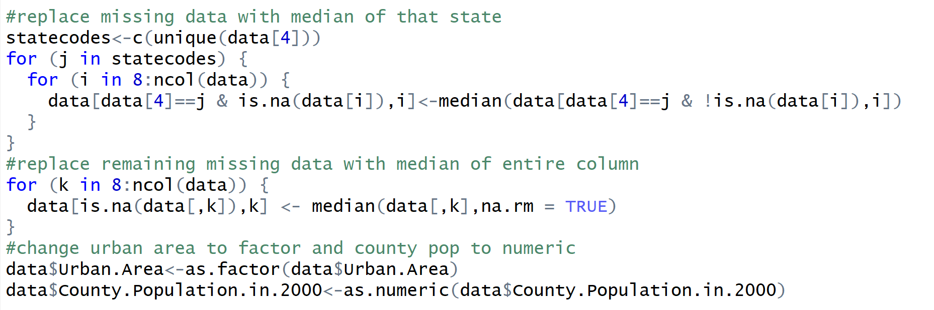
DATA CLEANSING SCRIPT
CRIME SCENE DO NOT CROSS
CRIME SCENE DO NOT CROSS
Notes:
We use the census data and each row is a county of United states and is grouped by states they belong to.All the columns are statistics for the counties and one of them is total crime rate.We want to use the statistics to predict total crime rate for each counties.
There are two states that did not report their total crime rate we took them out.(only use the 48 states data)
After taking them out,there are still some missing values and instead of getting rid of them, we first tried to replace the missing values with their state median for that column. And we realized that only doing this cannot get rid of all the missing values. This is because for some states, they do not have the statistics for that specific column. And we decide to replace those with the column median.

Slide 7
OBJECTIVE
CRIME SCENE DO NOT CROSS
Goal: Use the statistical measures created to predict crime rate which will then be used to select a storage facility location in either Florida or Wisconsin.
Focusing on “Total Crime Rate” we will decide which counties in Wisconsin and Florida are safe for our facility location.
CRIME SCENE DO NOT CROSS
Notes:
We use the census data and each row is a county of United states and is grouped by states they belong to.All the columns are statistics for the counties and one of them is total crime rate.We want to use the statistics to predict total crime rate for each counties.
There are two states that did not report their total crime rate we took them out.(only use the 48 states data)
After taking them out,there are still some missing values and instead of getting rid of them, we first tried to replace the missing values with their state median for that column. And we realized that only doing this cannot get rid of all the missing values. This is because for some states, they do not have the statistics for that specific column. And we decide to replace those with the column median.

Slide 8
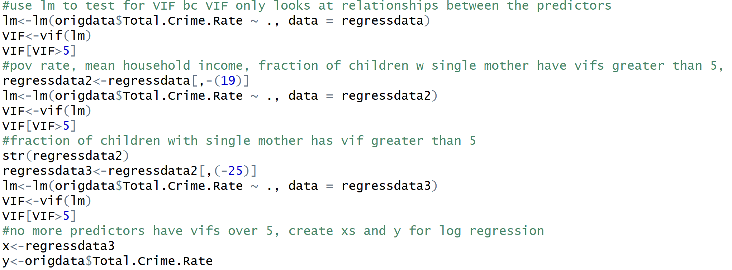
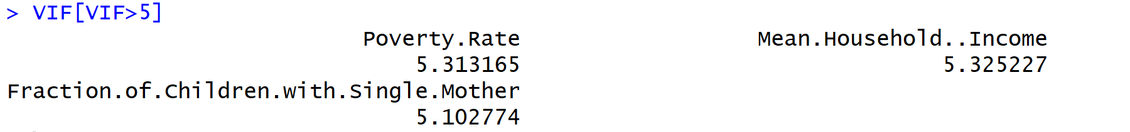
LINEAR REGRESSION
1. Test Collinearity: use VIF function, remove from the highest
CRIME SCENE DO NOT CROSS
CRIME SCENE DO NOT CROSS
Notes:
We use the census data and each row is a county of United states and is grouped by states they belong to.All the columns are statistics for the counties and one of them is total crime rate.We want to use the statistics to predict total crime rate for each counties.
There are two states that did not report their total crime rate we took them out.(only use the 48 states data)
After taking them out,there are still some missing values and instead of getting rid of them, we first tried to replace the missing values with their state median for that column. And we realized that only doing this cannot get rid of all the missing values. This is because for some states, they do not have the statistics for that specific column. And we decide to replace those with the column median.

Slide 9
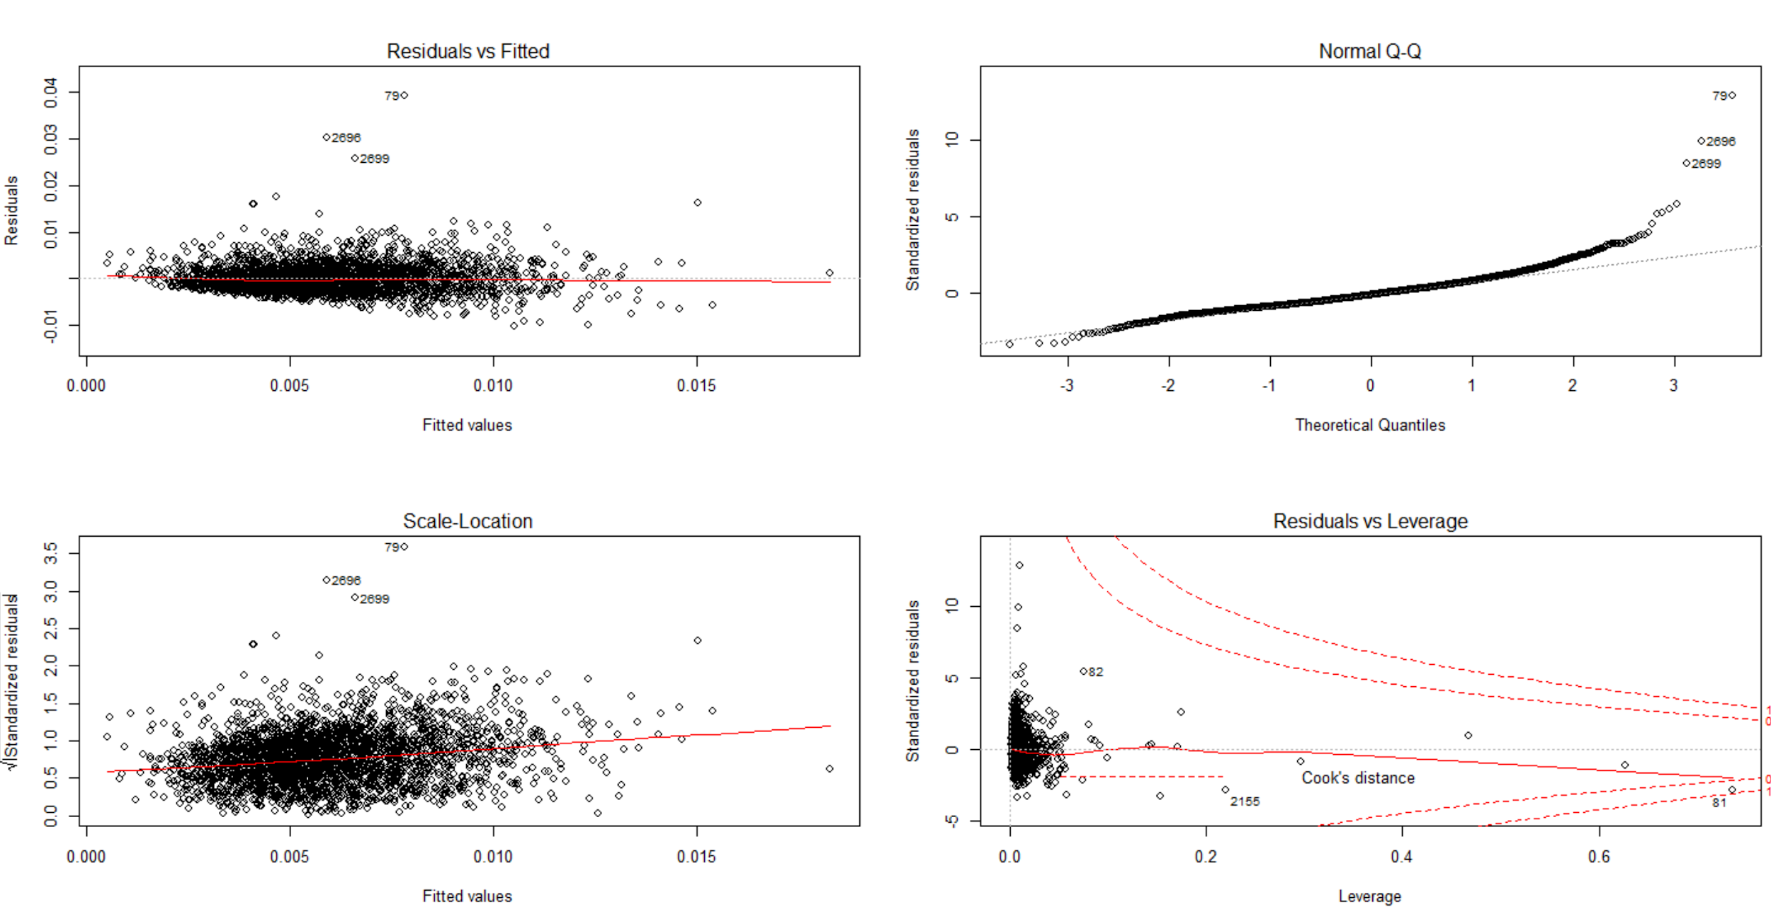
LINEAR REGRESSION
CRIME SCENE DO NOT CROSS
Regression model run with remaining 26 predictors
Remove observation 81 because it is a high leverage point
CRIME SCENE DO NOT CROSS

Slide 10
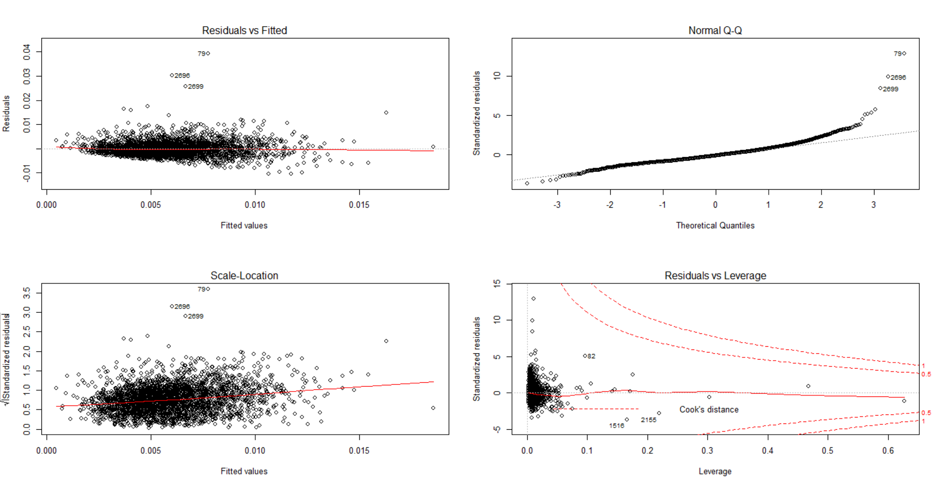
LINEAR REGRESSION
CRIME SCENE DO NOT CROSS
CRIME SCENE DO NOT CROSS
Notes:
We use the census data and each row is a county of United states and is grouped by states they belong to.All the columns are statistics for the counties and one of them is total crime rate.We want to use the statistics to predict total crime rate for each counties.
There are two states that did not report their total crime rate we took them out.(only use the 48 states data)
After taking them out,there are still some missing values and instead of getting rid of them, we first tried to replace the missing values with their state median for that column. And we realized that only doing this cannot get rid of all the missing values. This is because for some states, they do not have the statistics for that specific column. And we decide to replace those with the column median.

Slide 11
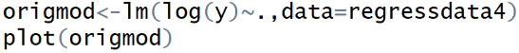
LINEAR REGRESSION
CRIME SCENE DO NOT CROSS
Crime rate does not appear to be a linear function of our independent variables
So we took a log of crime rate, our dependent variable
CRIME SCENE DO NOT CROSS
Notes:
We use the census data and each row is a county of United states and is grouped by states they belong to.All the columns are statistics for the counties and one of them is total crime rate.We want to use the statistics to predict total crime rate for each counties.
There are two states that did not report their total crime rate we took them out.(only use the 48 states data)
After taking them out,there are still some missing values and instead of getting rid of them, we first tried to replace the missing values with their state median for that column. And we realized that only doing this cannot get rid of all the missing values. This is because for some states, they do not have the statistics for that specific column. And we decide to replace those with the column median.

Slide 12
LINEAR REGRESSION
CRIME SCENE DO NOT CROSS
5. Subset predictors
We decided to use BIC for our standard to pick out variables. We choose BIC as our standard because BIC gives a higher penalty on adding new variables. Since the dataset has some missing values in some columns and we made assumption for those data, acquiring new data in order to get more accurate predictors will increase current costs.
CRIME SCENE DO NOT CROSS
Notes:
We use the census data and each row is a county of United states and is grouped by states they belong to.All the columns are statistics for the counties and one of them is total crime rate.We want to use the statistics to predict total crime rate for each counties.
There are two states that did not report their total crime rate we took them out.(only use the 48 states data)
After taking them out,there are still some missing values and instead of getting rid of them, we first tried to replace the missing values with their state median for that column. And we realized that only doing this cannot get rid of all the missing values. This is because for some states, they do not have the statistics for that specific column. And we decide to replace those with the column median.

Slide 13
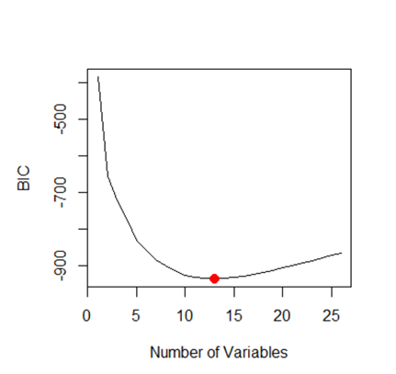
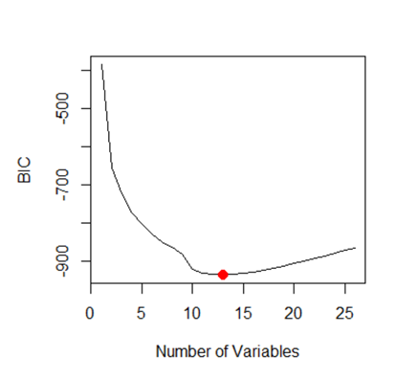
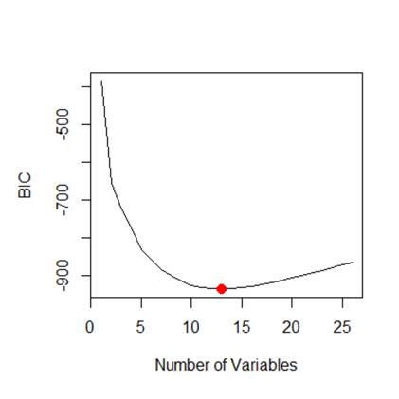
LINEAR REGRESSION
Full Selection Forward Selection Backward Selection
CRIME SCENE DO NOT CROSS
CRIME SCENE DO NOT CROSS
Notes:
We use the census data and each row is a county of United states and is grouped by states they belong to.All the columns are statistics for the counties and one of them is total crime rate.We want to use the statistics to predict total crime rate for each counties.
There are two states that did not report their total crime rate we took them out.(only use the 48 states data)
After taking them out,there are still some missing values and instead of getting rid of them, we first tried to replace the missing values with their state median for that column. And we realized that only doing this cannot get rid of all the missing values. This is because for some states, they do not have the statistics for that specific column. And we decide to replace those with the column median.

Slide 14
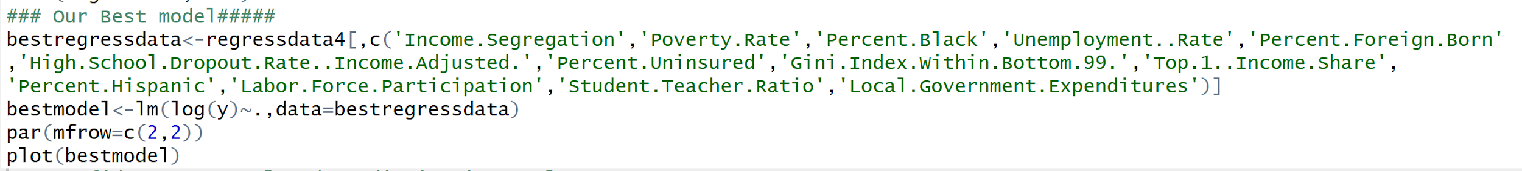
LINEAR REGRESSION
After performing the full, forward and backward selection methods, it was revealed that 13 predictors minimized BIC, and all three processes, chose the same 13 predictors though their own methods.
Our best model with 13 predictors chosen by all three methods
CRIME SCENE DO NOT CROSS
CRIME SCENE DO NOT CROSS

Slide 15
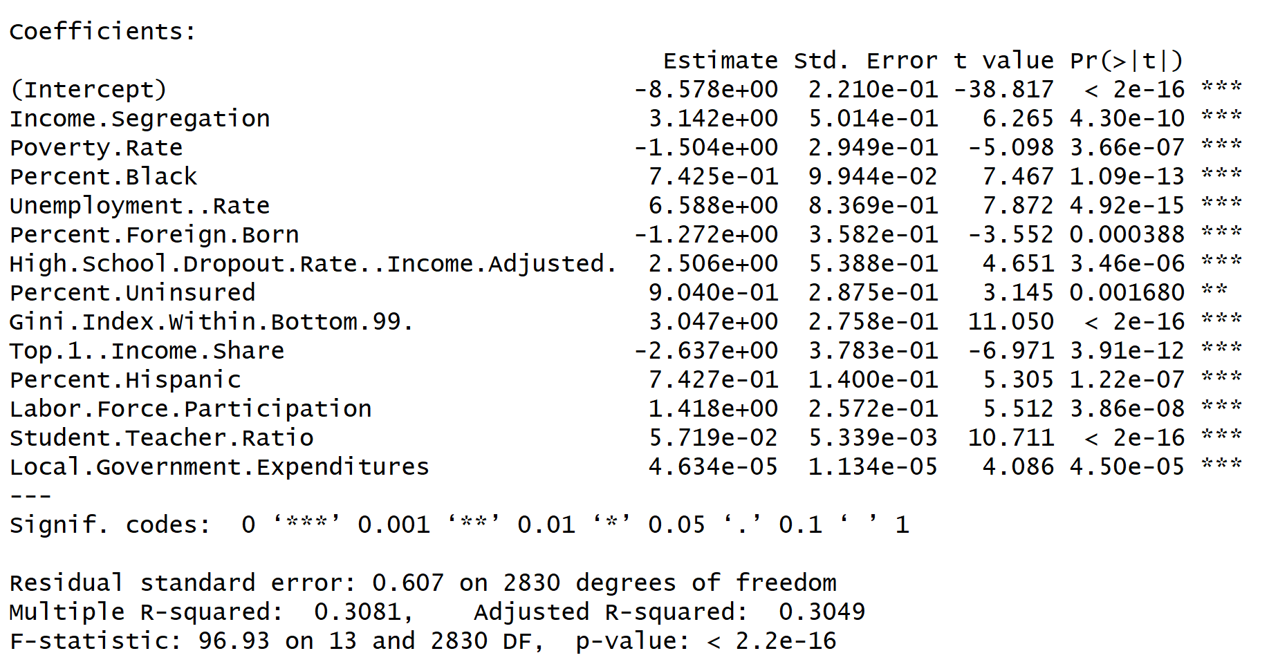
LINEAR REGRESSION
CRIME SCENE DO NOT CROSS
CRIME SCENE DO NOT CROSS

Slide 16
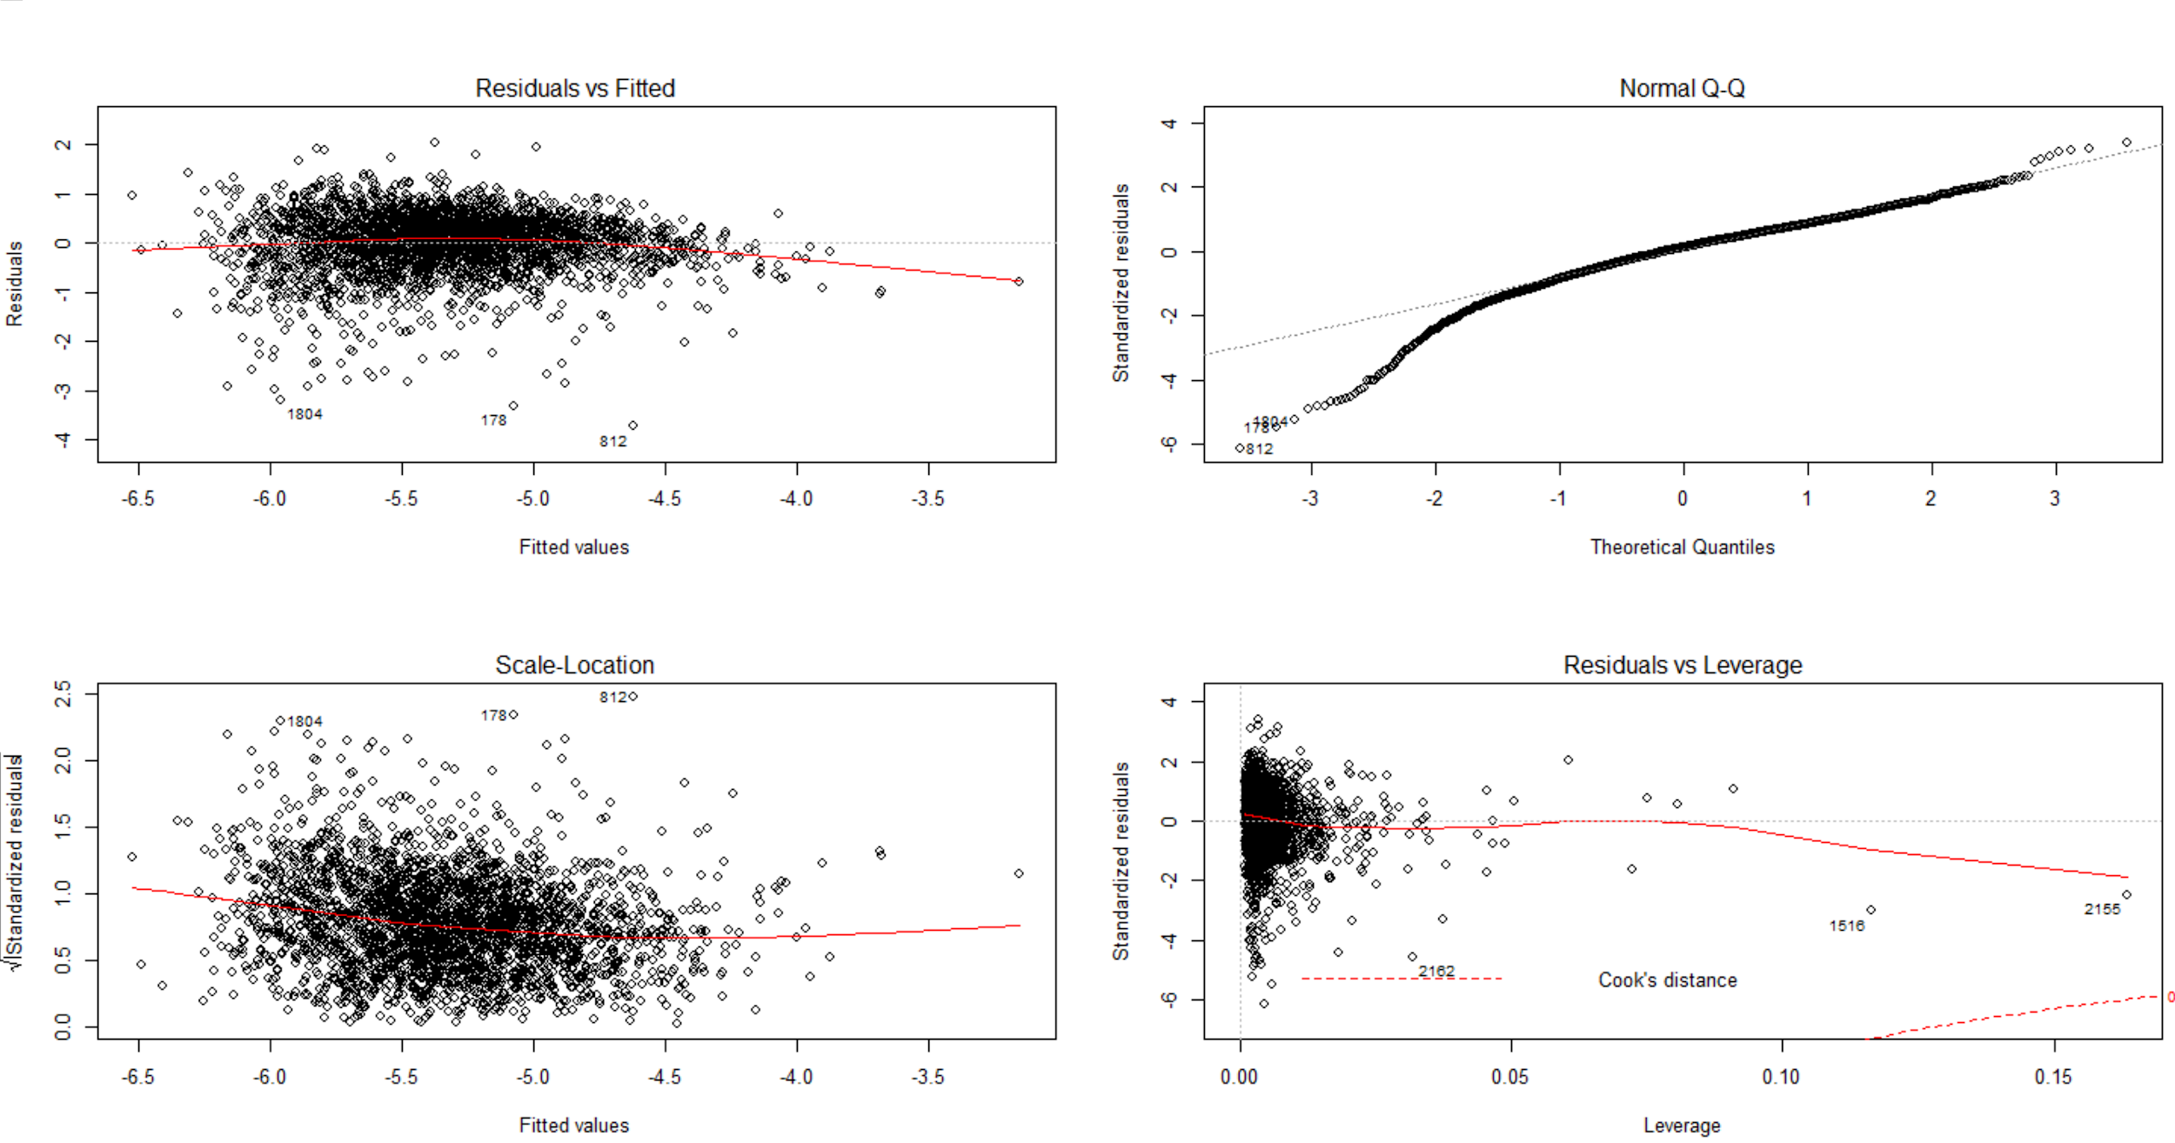
LINEAR REGRESSION
CRIME SCENE DO NOT CROSS
CRIME SCENE DO NOT CROSS

Slide 17
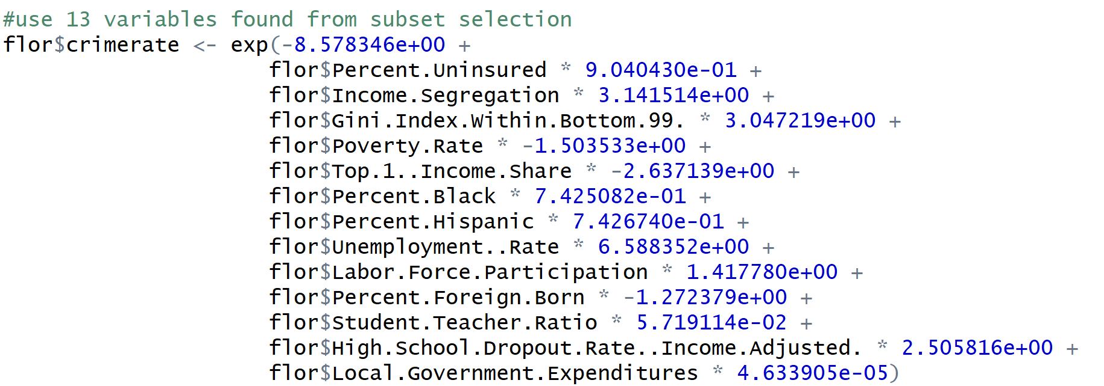
LINEAR REGRESSION
6. Put all the predictors information for Florida and Wisconsin in two separate csv files and clean the data.
Use the 13 predictors that were picked to predict total crime rate in Florida and Wisconsin
CRIME SCENE DO NOT CROSS
CRIME SCENE DO NOT CROSS
Notes:
We use the census data and each row is a county of United states and is grouped by states they belong to.All the columns are statistics for the counties and one of them is total crime rate.We want to use the statistics to predict total crime rate for each counties.
There are two states that did not report their total crime rate we took them out.(only use the 48 states data)
After taking them out,there are still some missing values and instead of getting rid of them, we first tried to replace the missing values with their state median for that column. And we realized that only doing this cannot get rid of all the missing values. This is because for some states, they do not have the statistics for that specific column. And we decide to replace those with the column median.

Slide 18
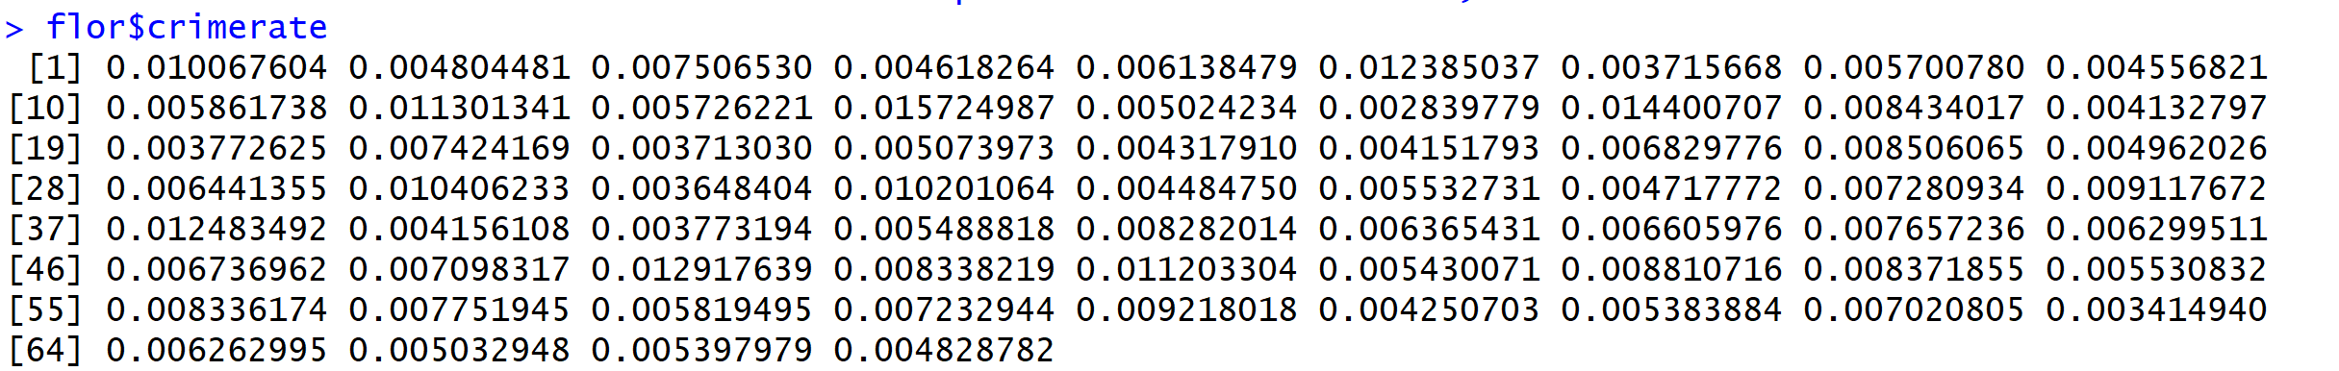
LINEAR REGRESSION
CRIME SCENE DO NOT CROSS
Florida Crime Rate Prediction Result
CRIME SCENE DO NOT CROSS
Notes:
We use the census data and each row is a county of United states and is grouped by states they belong to.All the columns are statistics for the counties and one of them is total crime rate.We want to use the statistics to predict total crime rate for each counties.
There are two states that did not report their total crime rate we took them out.(only use the 48 states data)
After taking them out,there are still some missing values and instead of getting rid of them, we first tried to replace the missing values with their state median for that column. And we realized that only doing this cannot get rid of all the missing values. This is because for some states, they do not have the statistics for that specific column. And we decide to replace those with the column median.

Slide 19
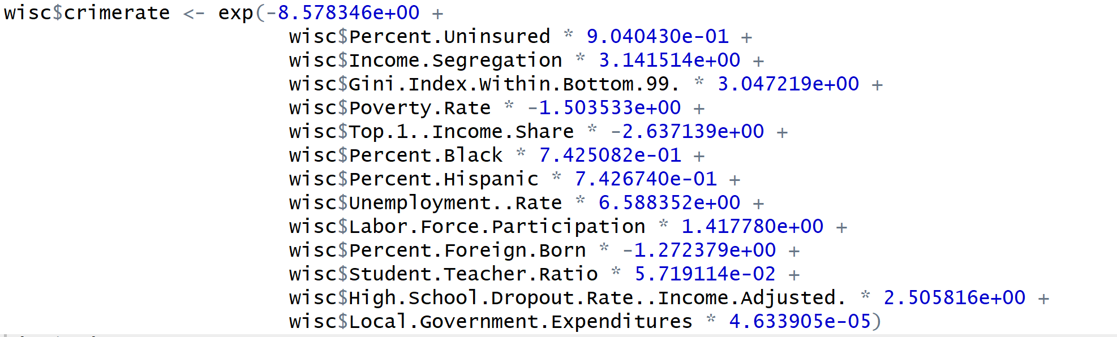
LINEAR REGRESSION
CRIME SCENE DO NOT CROSS
Wisconsin Crime Rate Prediction
CRIME SCENE DO NOT CROSS
Notes:
We use the census data and each row is a county of United states and is grouped by states they belong to.All the columns are statistics for the counties and one of them is total crime rate.We want to use the statistics to predict total crime rate for each counties.
There are two states that did not report their total crime rate we took them out.(only use the 48 states data)
After taking them out,there are still some missing values and instead of getting rid of them, we first tried to replace the missing values with their state median for that column. And we realized that only doing this cannot get rid of all the missing values. This is because for some states, they do not have the statistics for that specific column. And we decide to replace those with the column median.

Slide 20
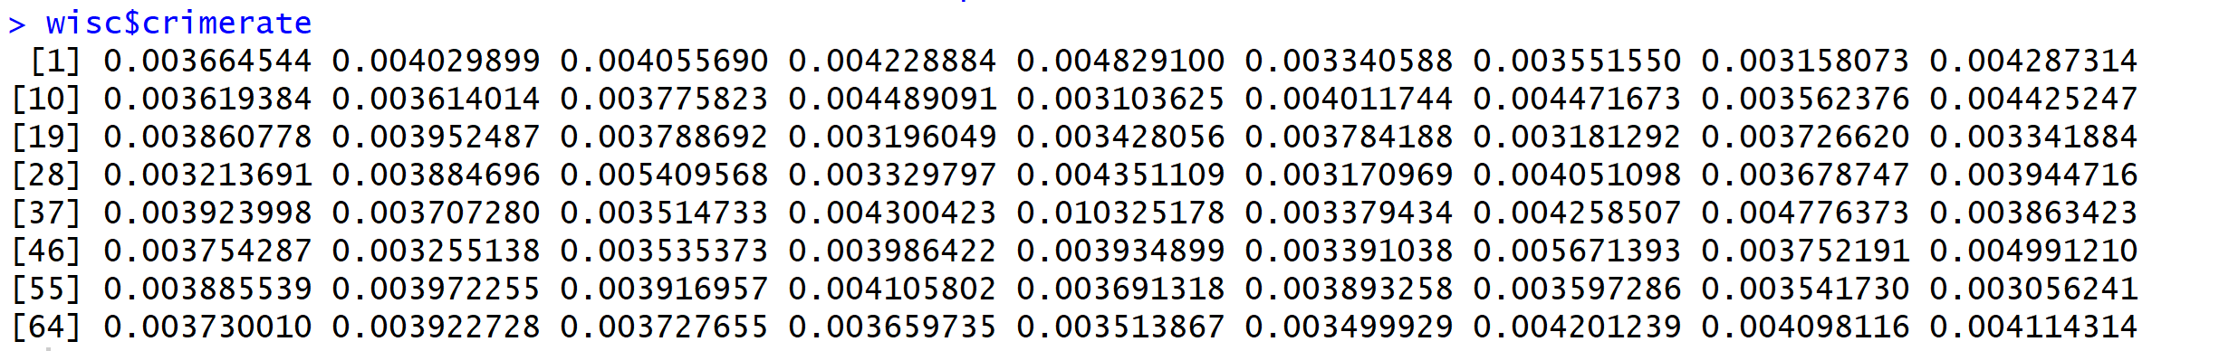
LINEAR REGRESSION
CRIME SCENE DO NOT CROSS
Wisconsin Crime Rate Prediction Result
CRIME SCENE DO NOT CROSS
Notes:
We use the census data and each row is a county of United states and is grouped by states they belong to.All the columns are statistics for the counties and one of them is total crime rate.We want to use the statistics to predict total crime rate for each counties.
There are two states that did not report their total crime rate we took them out.(only use the 48 states data)
After taking them out,there are still some missing values and instead of getting rid of them, we first tried to replace the missing values with their state median for that column. And we realized that only doing this cannot get rid of all the missing values. This is because for some states, they do not have the statistics for that specific column. And we decide to replace those with the column median.

Slide 21
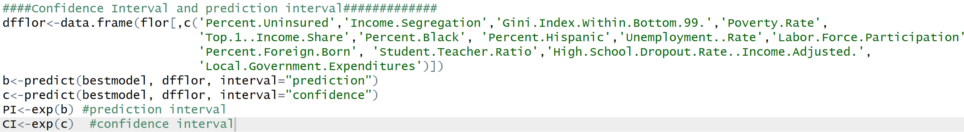
LINEAR REGRESSION
6. Confidence interval and prediction interval
CRIME SCENE DO NOT CROSS
CRIME SCENE DO NOT CROSS
Notes:
We use the census data and each row is a county of United states and is grouped by states they belong to.All the columns are statistics for the counties and one of them is total crime rate.We want to use the statistics to predict total crime rate for each counties.
There are two states that did not report their total crime rate we took them out.(only use the 48 states data)
After taking them out,there are still some missing values and instead of getting rid of them, we first tried to replace the missing values with their state median for that column. And we realized that only doing this cannot get rid of all the missing values. This is because for some states, they do not have the statistics for that specific column. And we decide to replace those with the column median.

Slide 22
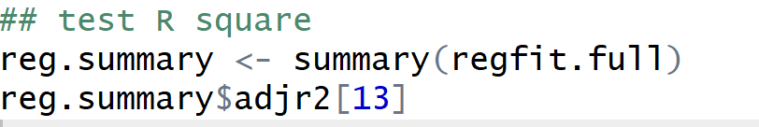
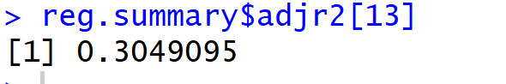
LINEAR REGRESSION
CRIME SCENE DO NOT CROSS
Adjusted R Square
CRIME SCENE DO NOT CROSS
Notes:
We use the census data and each row is a county of United states and is grouped by states they belong to.All the columns are statistics for the counties and one of them is total crime rate.We want to use the statistics to predict total crime rate for each counties.
There are two states that did not report their total crime rate we took them out.(only use the 48 states data)
After taking them out,there are still some missing values and instead of getting rid of them, we first tried to replace the missing values with their state median for that column. And we realized that only doing this cannot get rid of all the missing values. This is because for some states, they do not have the statistics for that specific column. And we decide to replace those with the column median.

Slide 23
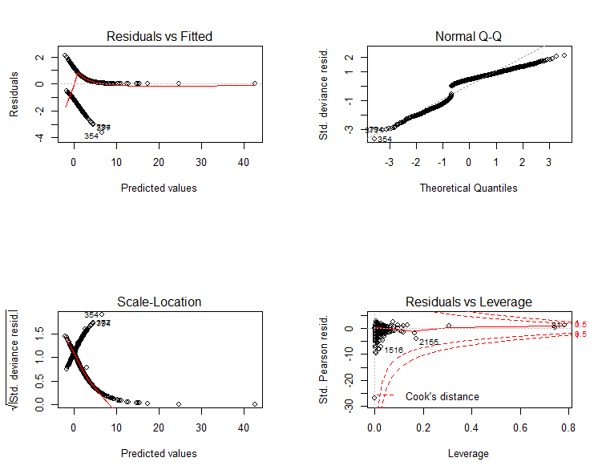
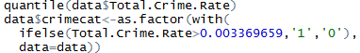
CLASSIFICATION
CRIME SCENE DO NOT CROSS
No high leverage points
Added a crime category variable
0 <- safe county
1 <- unsafe
Split our data into train and test sets using an 80/20 split
CRIME SCENE DO NOT CROSS

Slide 24
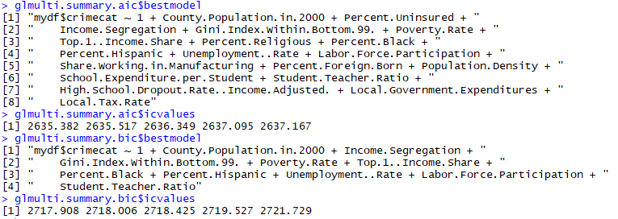
CLASSIFICATION
AIC vs BIC subset selection
CRIME SCENE DO NOT CROSS
CRIME SCENE DO NOT CROSS
Notes:
After cleaning the data and making sure our variables did not have high VIF values, we ran all of our predictors through the glmulti function using AIC and BIC subset selection. These were done using the genetic method because we had over 25 independent variables. This visual shows what the chosen variables were. We kept the top 5 models for each subset selection

Slide 25
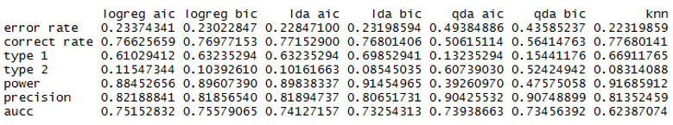
CLASSIFICATION
CRIME SCENE DO NOT CROSS
Cutoff = .5
Knn produces lowest error rate
Knn produces lowest type 2 error
CRIME SCENE DO NOT CROSS
Notes:
Discuss what is type 1 and type 2 error and the importance
Switched the cutoff from .5 to .4 to decrease type 2 error rate and as seen on the next table all the type 2 error rates have decreased. However this resulted in a tradeoff where the type 1 error rate increased. We accept this tradeoff because in terms of our business context it is more costly to call a county safe and build a facility in it when it is actually unsafe then it is to call a county unsafe when it is actually safe.

Slide 26
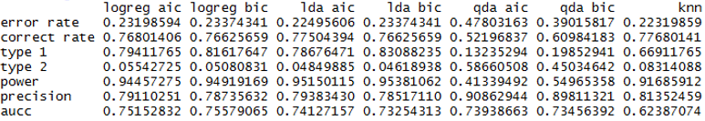
CLASSIFICATION
CRIME SCENE DO NOT CROSS
Cutoff = .4
Knn still has lowest error rate
LDA BIC has lowest type 2 error
CRIME SCENE DO NOT CROSS
Notes:
Discuss what is type 1 and type 2 error and the importance

Slide 27
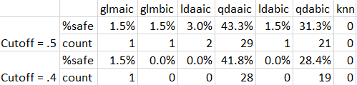
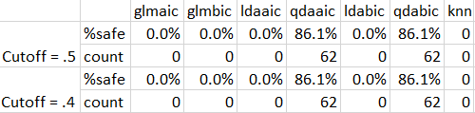
BACK TO BUSINESS
CRIME SCENE DO NOT CROSS
Florida
Wisconsin
CRIME SCENE DO NOT CROSS
(QDA methods had high type 2 error rates, so we chose not look at this.)
Notes:
So even when we lowered the cutoff more than .4 - the QDA improved fractionally but not enough to matter
In regards to our model, we did not choose to go in depth with a lower cutoff because we wanted an answer for our county at the end

Slide 28
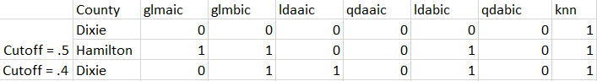
CONCLUSION
There are no safe locations in Wisconsin
2 potential locations in Florida
Ultimately we chose Dixie, Florida. When the cutoff is decreased from .5 to .4, Dixie is the only city that continues to meet the constraints set and, therefore, it is considered more safe.
CRIME SCENE DO NOT CROSS
CRIME SCENE DO NOT CROSS
CRIME SCENE DO NOT CROSS
CRIME SCENE DO NOT CROSS
Notes:
County Name Urban Area County Population in 2000 Percent Uninsured Income Segregation Racial Segregation Gini Index Within Bottom 99% Poverty Rate Top 1% Income Share Percent Religious Percent Black Percent Hispanic Unemployment Rate Labor Force Participation Share Working in Manufacturing Percent Foreign Born Migration Inflow Rate Migration Outflow Rate Population Density Mean Household Income Median House Value School Expenditure per Student Student-Teacher Ratio Test Score Percentile (Income Adjusted) High School Dropout Rate (Income Adjusted) Percent College Grads Fraction of Children with Single Mother Local Government Expenditures Local Tax Rate Dixie 1 13827 0.216500034 0.002850295 0.035486899 0.295600116 0.191105857 0.04699 0.442612305 0.089028711 0.018008245 0.055142149 0.446305424 0.104943626 0.020394881 0.022998481 0.025312794 19.64020729 24957.0918 82246.1 5.89281102 16.45699526 -3.3614223 -0.017129218 0.068000002 0.2168421 1559.65979 0.019827694

Slide 29
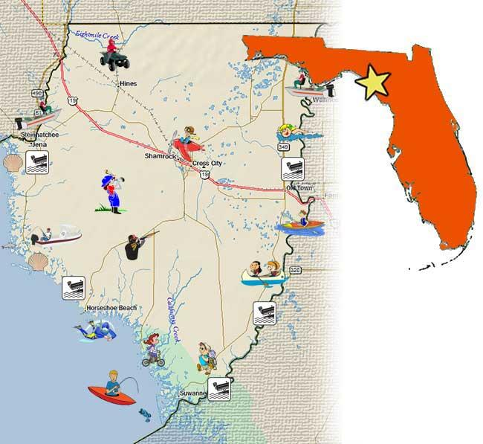

CONCLUSION
DIXIE
CRIME SCENE DO NOT CROSS
CRIME SCENE DO NOT CROSS
CRIME SCENE DO NOT CROSS
CRIME SCENE DO NOT CROSS
Notes:
County Name Urban Area County Population in 2000 Percent Uninsured Income Segregation Racial Segregation Gini Index Within Bottom 99% Poverty Rate Top 1% Income Share Percent Religious Percent Black Percent Hispanic Unemployment Rate Labor Force Participation Share Working in Manufacturing Percent Foreign Born Migration Inflow Rate Migration Outflow Rate Population Density Mean Household Income Median House Value School Expenditure per Student Student-Teacher Ratio Test Score Percentile (Income Adjusted) High School Dropout Rate (Income Adjusted) Percent College Grads Fraction of Children with Single Mother Local Government Expenditures Local Tax Rate Dixie 1 13827 0.216500034 0.002850295 0.035486899 0.295600116 0.191105857 0.04699 0.442612305 0.089028711 0.018008245 0.055142149 0.446305424 0.104943626 0.020394881 0.022998481 0.025312794 19.64020729 24957.0918 82246.1 5.89281102 16.45699526 -3.3614223 -0.017129218 0.068000002 0.2168421 1559.65979 0.019827694

Slide 30
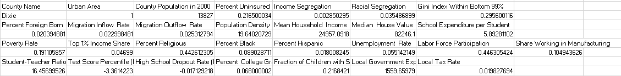
Dixie Variables
CRIME SCENE DO NOT CROSS
CRIME SCENE DO NOT CROSS
Notes:
Backup slides

Slide 31
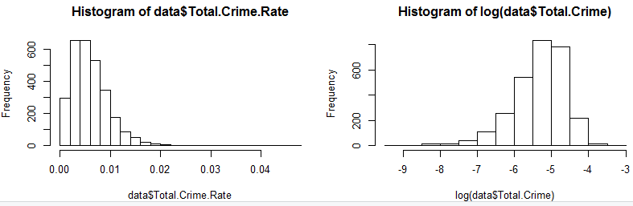
Crime Rate Distributions
CRIME SCENE DO NOT CROSS
CRIME SCENE DO NOT CROSS

